Slide 1
Chat Program
CS 3800
Codebreakers
Danny Prakonekham
Hari Kifle
Ahmed Elsayed

Slide 2
Design - Server
Launch the Server
The server will wait for a connection
When the client connects, the server will spawn a new thread and ask for a username by sending the message USERNAME
After receiving a username, The server will check clientNames, which is a HashSet that contains all connected client names, for duplicates and then add it to the set
If the username is unique, the server will then send an acknowledgement message, NAMECONFIRMED, to the user
The server will then broadcast to all users that the new user has join the server

Slide 3
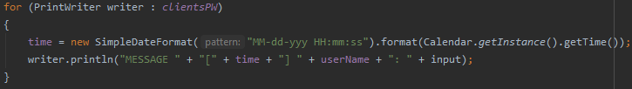
Broadcasting to all users
The server keeps a HashSet called clientsPW, which contains of all connected clients print writers
Using a loop, we write to every connected client’s PrintWriter to distribute the message
The message contents

Slide 4
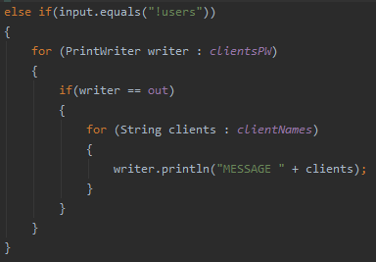
Listing all Connected Users
Print each name in the HashSet, clientNames, to the user who issued the command
“!users”

Slide 5
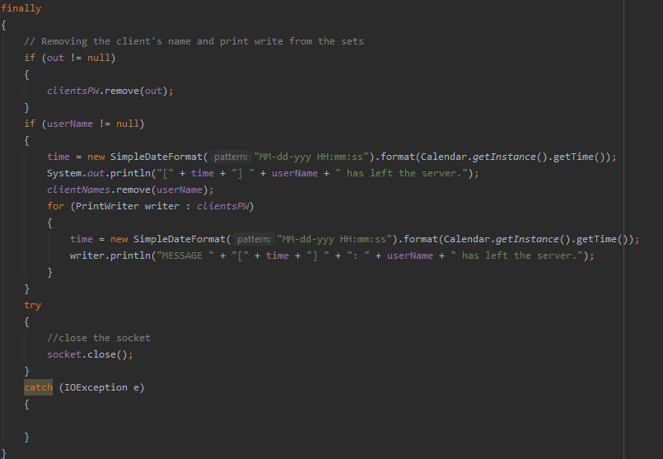
Disconnecting a user

Slide 6
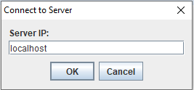
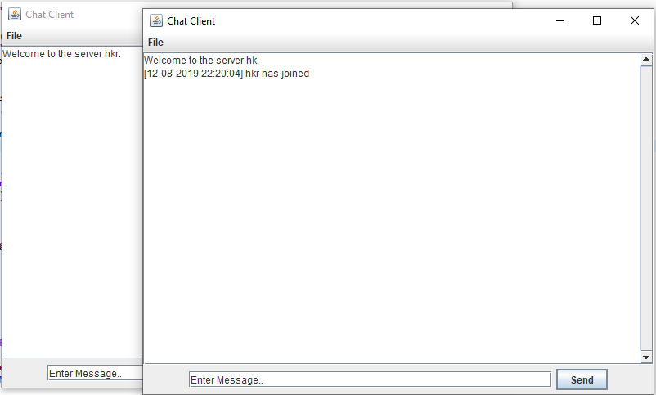
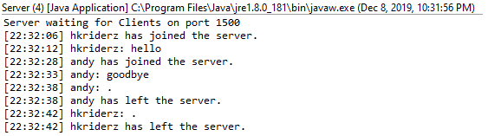
Design - Client
Launch the client
The client will ask to input the server IP
Once you input the server IP (localhost), it will log you in to the server after giving a unique username.
After that, it adds the users into the chat.
When a “.” is sent, the user is disconnected.

Slide 7
Member’s Tasks
Danny Prakonekham
GUI and Client integration
Hari Kifle
Server
Ahmed ElSayed
Client

